Slide 1
Introduction to Databases - Application July 2022

Slide 2
Roadmap
Conceptual Overview of Databases
Big picture of database design
Learn basic SQL queries with Harry Potter Database
How data analysts use databases: Steven Zhang

Slide 3
Learning Outcomes
Identify the code required to utilize data
Write SQL queries to
Select data
Sort and remove duplicates
Filter values
Calculate new values
Aggregate data
Combine or join tables

Slide 4
Basic Commands
Selecting data - SELECT, FROM, WHERE, LIKE
Aggregation - min, max, avg, count, GROUP BY
Combining data - JOIN, ON

Slide 5
Using DB Browser
As a data analyst, you will most likely work with an existing database, so it will be to your advantage to become familiar with SQL commands.
Open up the HarryPotter.db on DB Browser for SQLite
https://sqliteonline.com/
Notes:
Work in DB Browser – why??
Instead of building it from scratch
Try to import CSV
You will have the database and load it now – and why will I give it to them?

Slide 6
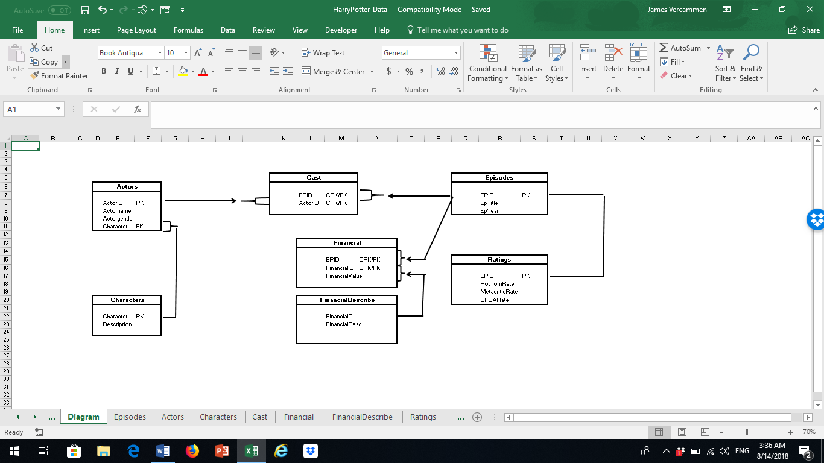

Slide 7
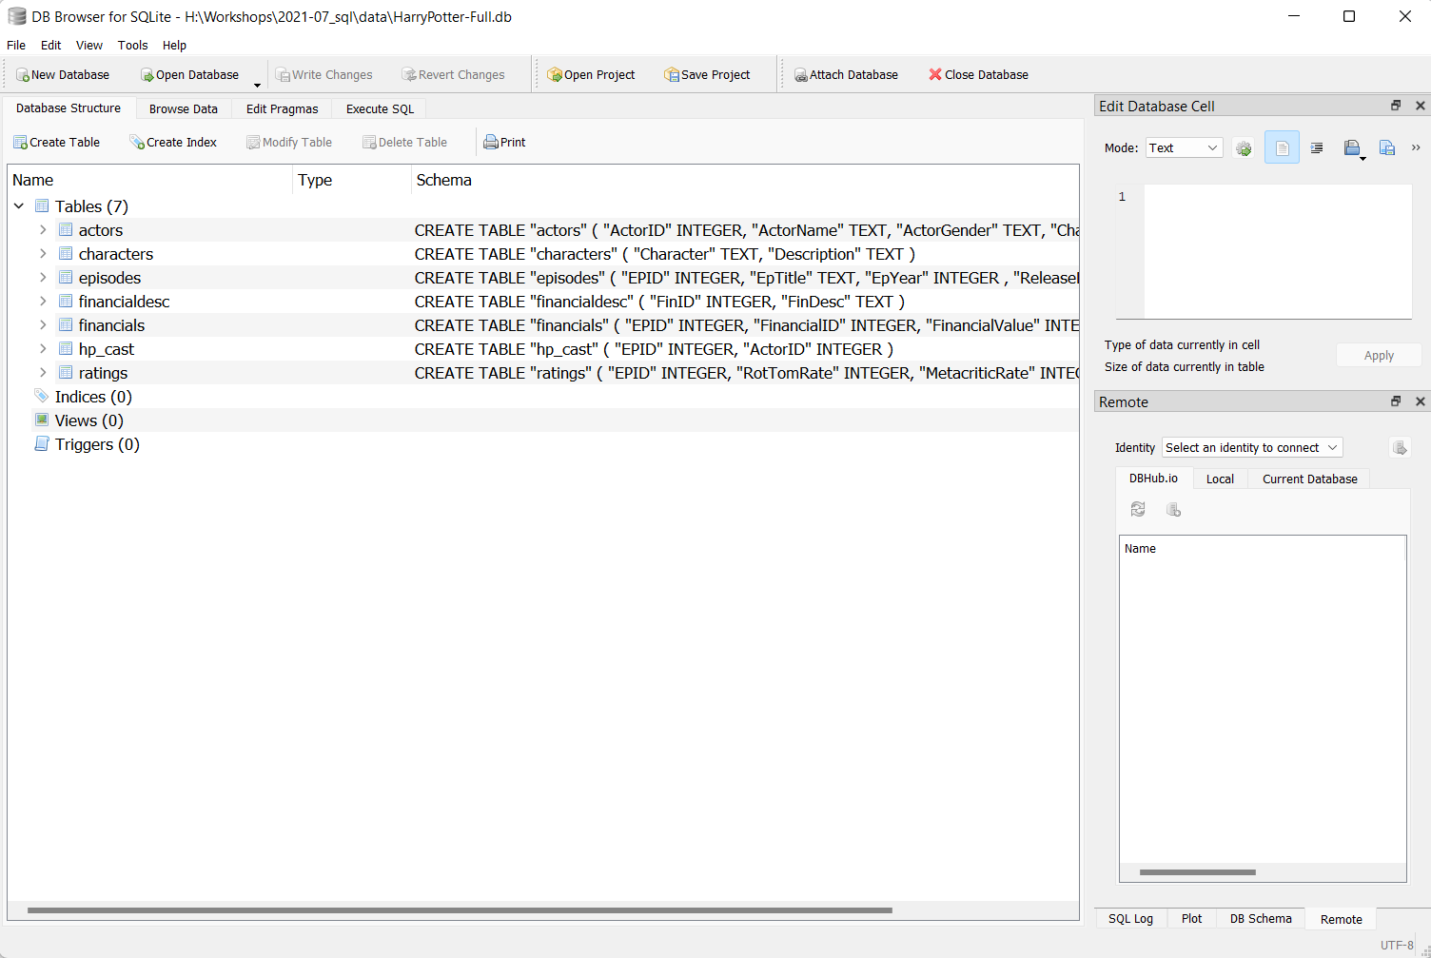

Slide 8
Selecting data
A typical query has the form
SELECT <column1>, <column2>, …
FROM <table name>
WHERE <CONDITIONS>;
The result is a new table called the result set.
Notes:
In SQL, getting to know the data or seeing it like you do in a spreadsheet starts with the SELECT keyword.
The most common operation in SQL is the query, which is performed with the SELECT statement
The semicolon at the end of the query tells the database manager that the query is complete and ready to run.

Slide 9
Selecting Data
How do we know all the columns and data of a particular table?
Use an asterisk (*) to select all the columns of the queried table(s)
SELECT * FROM actors;
What if we only want to see 5 data points?
SELECT * FROM actors LIMIT 5;

Slide 10
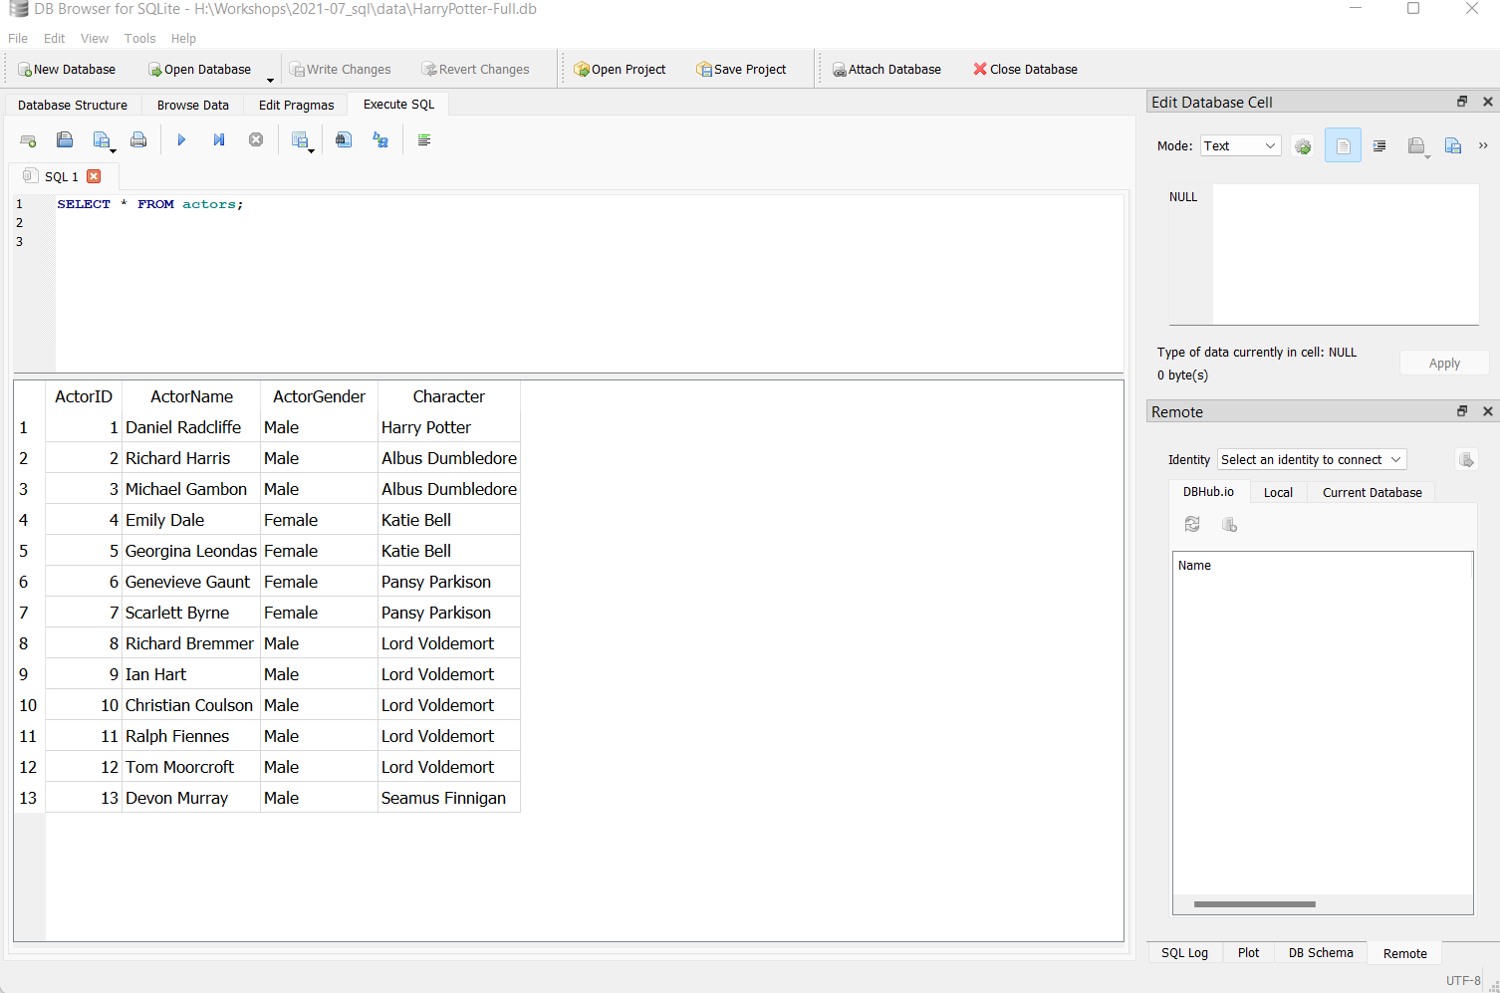
Working with DB for SQLite
2 – Type your queries then ctrl + enter or cmd + enter
1 – Click Execute SQL tab
3 – see output here

Slide 11
Selecting data
What is the gender distribution of our actors database?

Slide 12
Selecting data
What is the gender distribution of our actors database?
SELECT ActorName, ActorGender FROM actors;

Slide 13
Selecting Data
Use AS to name columns of the result set
SELECT ActorName AS Name,
ActorGender AS Gender
FROM actors;

Slide 14
Activity – Selecting Data
What are the names of the characters that we have actor data of?
Notes:
SELECT character FROM characters;
So far: We introduced SELECT and FROM to get values from a database table. And learned that SQL is case-insensitive, but data is case-sensitive.
A db manager is a program that manipulates information stored in a database.

Slide 15
Activity – Selecting Data
To determine which characters we have actor data of, we can look at the actors table
SELECT Character FROM actors;
SELECT DISTINCT Character FROM actors;
SELECT DISTINCT Character FROM actors
LIMIT 3;
Notes:
In a table, it is not unusual for a column to contain rows with duplicate values. In the characters data for example, we have multiple actors that play the same character.
We can use the DISTINCT keyword as part of a query that eliminates duplicates and shows only unique values. We can also use LIMIT keyword to limit the results we get back.
AND WHY WE WOULD USE THESE – MANAGER PERSON WHO WOULD NEED THIS TO ANSWER CERTAIN QUESTIONS. IT’S ALL ABOUT DECISION MAKING
SELECT character FROM actors
LIMIT 5;
SELECT DISTINCT character FROM actors
LIMIT 5;

Slide 16
Sorting and Removing Duplicates
Database records are not stored in a particular order.
If we want the query results to be ordered in a particular way, we can use the ORDER BY keyword.
SELECT Character, ActorName FROM actors
ORDER BY ActorName (ASC/DESC);
SELECT Character, ActorName FROM actors
ORDER BY Character ASC, ActorName DESC;

Slide 17
Filtering rows with WHERE
What if we want to see the different actors who played Lord Voldemort?
SELECT * FROM actors
WHERE Character = 'Lord Voldemort';
Notes:
One of the most powerful features of a database is the ability to filter data, meaning select or display only those records that match certain criteria.
The db manager executes the query in two steps. First, it checks each row in the actors column to see which ones satisfy the WHERE clause (Lord Voldemort). Second, it uses the column names after SELECT keyword to determine which columns to display.

Slide 18
Filtering with wildcards
To filter by partial matches, we use the LIKE keyword. The % symbol acts as a wildcard, matching any characters in that place.
For example, we want to know the title and release year of the episode that contains “Deathly”
SELECT * FROM episodes WHERE EpTitle LIKE '%Deathly%';

Slide 19
Filtering
We can use Boolean operators such as AND, OR, IN
We can query which episodes were released from 2005 to 2007.
SELECT EpTitle FROM episodes WHERE EpYear >= 2005 AND EpYear <= 2007;

Slide 20
Activity
Write a query that will display the episode ID and financial value of worldwide box office sales ordered in descending order
Hint financial id = 1 for worldwide box office sales
Notes:
SELECT EpID, FinancialValue
FROM financials
WHERE FinancialID = 1
ORDER BY FinancialValue DESC;

Slide 21
Activity
Write a query that will display the episode ID and financial value of worldwide box office sales ordered in descending order
SELECT EpID, FinancialValue
FROM financials
WHERE FinancialID = 1
ORDER BY FinancialValue DESC;

Slide 22
Basic Math & Stats in SQL
We use the SELECT keyword (similar to di command in Stata)
SELECT 2 + 2;
SELECT 9 – 1;
SELECT 3 * 4;
Notes:
In Stata you have di right? In SQL we use SELECT

Slide 23
Adding columns
How do we create a new index called “TotalRating” that adds the Rotten Tomato rating and BFCA Rating?
SELECT RotTomRate, BFCARate,
RotTomRate + BFCARate AS "TotalRating"
FROM ratings;
-- for comments!

Slide 24
Calculating new values
How do we convert the box office sales from USD to CDN?

Slide 25
Calculating new values
How do we convert the box office sales from USD to CDN?
SELECT *,
1.30 * FinancialValue AS "in CDN"
FROM financials;

Slide 26
Aggregation
Common aggregate functions:
min(), max(), avg(), sum()
Calculate average worldwide box office sales of all 8 episodes
SELECT round(avg(FinancialValue),0) FROM financials
WHERE FinancialID = 1;
Notes:
So far, we’ve performed math operations across columns in each row of a table.
SQL also allows you to calculate result from values within the same column using aggregate functions.

Slide 27
Activity - Aggregation
Which episode had the lowest worldwide box office sales?
How many different actors played Lord Voldemort?

Slide 28
Activity - Aggregation
Which episode had the lowest worldwide box office sales?
SELECT EPID, min(FinancialValue)
FROM financials
WHERE FinancialID = 1;

Slide 29
Activity - Aggregation
How many different actors played Lord Voldemort?
SELECT count(ActorName)
FROM actors
WHERE Character = "Lord Voldemort";

Slide 30
Activity
So far we have talked about
Select data
Sort and remove duplicates
Filter values
Calculate new values
Using these statements, what queries can you write in a sales database?
Notes:
Push them to think about how do they use this? When will they use it?
Sales, tracking, shipping, different uses
Get most selling product
Avg sales by month
Avg sales by product
Limited because so far we just look at queries for one table.
Now we’ll talk about joining tables to make our queries more useful

Slide 31
Joining tables
IN SQL, joins are used to link the tables within a relational database
Types of joins
JOIN or INNER JOIN
OUTER JOINs – LEFT*, RIGHT, FULL
CROSS JOIN
Notes:
Yesterday, we discussed the concept of a relational database. That is, data are stored across multiple tables but are somehow interconnected through keys. In our relational model, each table holds data on one entity, such as character, actors, episodes, financial value, rating, etc. – and each row in the table describes one of those entities. A process known as the table join allows us to link rows in one table to rows in other tables.
SQLite only supports the LEFT outer join. If you want to do a RIGHT JOIN in SQLite, then just flip the order of your joins

Slide 32
Review on keys
What is a primary key?
What is a foreign key?
Notes:
A primary key is a column whose values uniquely identify each row in a table.
FK is a referral to a PK of another table.

Slide 33
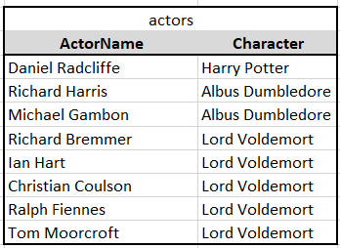
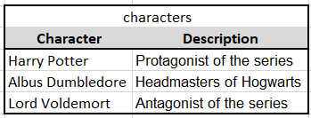
actors - characters
Notes:
Let’s take a look at 2 of our tables – actors and characters. The character column in the characters table is the PK because it uniquely identifies the characters. It’s a unique id for each description.
Meanwhile, the character column in actors is a foreign key because it serves as a reference to the character column of the characters table.
In our diagram, Harry Potter of our characters table is associated with Daniel Radcliffe in the actors table. Similarly, Albus Dumbledore is associated with Richard Harris and Michael Gambon. Lord Voldemort is associated with x, y, z. By setting up this reference table, we reduce redundancy.
What do you think is the FK
Do you think this is a one to one, one to many, or many to many?
One to many
Because? One character can be played by multiple actors
But multiple actors can only play one character.

Slide 34
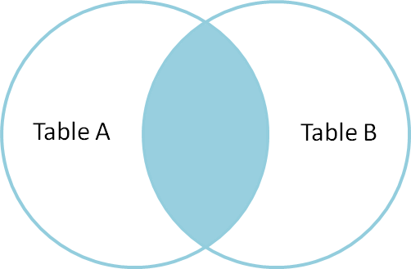
Inner join
An inner join produces only the set of records that match in both Table A and Table B
SELECT * FROM tableA
INNER JOIN tableB
ON tableA.PK = tableB.FK;

Slide 35
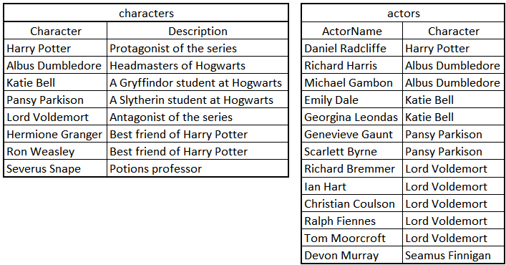
Activity – Inner Join
Write a query that returns the episode title and worldwide box office sales
Write a query that gives us the name of the actors, the character they played, and a description of their characters

Slide 36
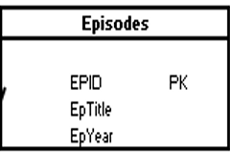
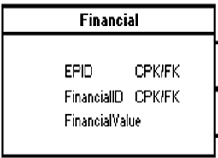
Activity – Inner Join
Write a query that returns the episode title and worldwide box office sales
SELECT e.Eptitle, f.financialValue
FROM episodes e
INNER JOIN financials f
ON e.EPID = f.EPID
WHERE f.FinancialID = 1;
Notes:
Let’s look at the overall JOIN ON syntax first before looking at other types of joins.
1. In this example, we included the asterisk wildcard after the SELECT statement to choose all columns in the financials and episodes columns.
2. Next, the JOIN keyword goes between the two tables we want to join – financials and episodes
3. Then for each table, we provide the table name, a period, and the column that contains the key values with an equal sign between the two table and column names.
When we run the query, the result includes all the values from both tables where EPID matches in both tables. So even though the data lives in 2 tables, we can query to pull the relevant data back together.
What happens if you forget ON? The JOIN will create a cross product of the two tables. Since financials has 24 records and episodes has 8 records, the output is 24*8 = 192 records

Slide 37
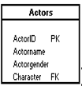

Activity – Inner join
Write a query that gives us the name of the actors, the character they played, and a description of their characters
SELECT a.Character, a.ActorName, c.Description
FROM actors a INNER JOIN characters c ON a.Character = c.Character;
Notes:
You can see that the results table do not contain data on Severus Snape, or Ron Weasley because while we have character data, we don’t have actor information. Similarly, while we have actor information on Seamus (Shaymus) finnigan we don’t have character details about him.

Slide 38
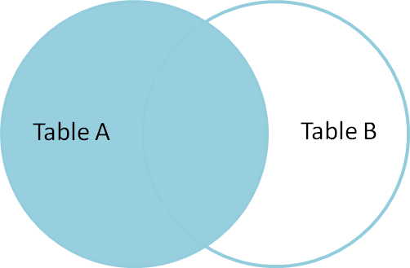
Left join
A left join produces a complete set of records from Table A, with matching records when available in Table B. If there is no match, the right side will contain null.
SELECT * FROM tableA
LEFT JOIN tableB
ON tableA.PK = tableB.FK;

Slide 39
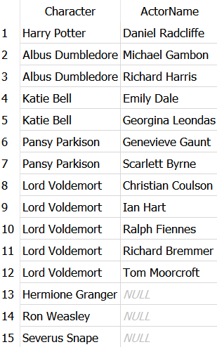
Activity – Left join
Write a query that will give us the result table on the right
Notes:
Using the syntax that I showed you and these two tables, what do you think should our query be to get the following table on the right?
The results show us that we have character description for Hermione (hermaiuhnee) granger, Ron Weasley, and Severus Snape but we don’t know who was casted for these roles.

Slide 40
Activity – Left join
SELECT c.Character, a.ActorName
FROM characters c
LEFT JOIN actors a
ON c.Character = a.Character;

Slide 41
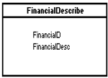

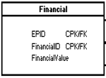
Joining (more) data
What if we want to show the episode title, financial description, box office sales?
SELECT episodes.EpTitle, financialdesc.FinDesc, financials.FinancialValue
FROM financials JOIN episodes JOIN financialdesc
ON financials.EPID = episodes.EPID
AND financials.FinancialID = financialdesc.FinID;

Slide 42
Activity
Create a query that shows Top 3 highest ranked episodes according to the Rotten Tomato rating
Write a SQL statement that displays the name of the actors, the episodes, and the rotten tomato rating for ratings with greater than 90
What were average Worldwide and North American box office sales of all 8 movie episodes?
.

Slide 43
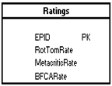

Activity
Create a query that shows Top 3 highest ranked episodes according to the Rotten Tomato rating
.
SELECT *
FROM episodes e
LEFT JOIN ratings r
ON e.EPID = r.EPID
ORDER BY r.RotTomRate DESC
LIMIT 3;

Slide 44

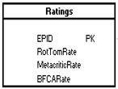
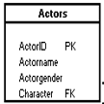

Activity
Write a SQL statement that displays the name of the actors, the episodes, and the rotten tomato rating for ratings with greater than 90
SELECT a.ActorName, ep.EpTitle, r.RotTomRate
FROM actors a INNER JOIN hp_cast c INNER JOIN episodes ep INNER JOIN ratings r
ON a.ActorID = c.ActorID
AND c.EPID = ep.EPID
AND ep.EPID = r.EPID
WHERE RotTomRate > 90;

Slide 46
Activity
What were average Worldwide and North American box office sales of all 8 movie episodes?
SELECT ep.EpTitle, ep.EPID, avg(f.FinancialValue) AS "Average Sales"
FROM financials f
LEFT JOIN episodes ep
LEFT JOIN financialdesc fd
ON f.EPID = ep.EPID
AND f.FinancialID = fd.FinID
WHERE fd.FinID = 2 OR fd.FinID = 1
GROUP BY ep.EpTitle
ORDER BY ep.EPID;

Slide 47
Recap
Write SQL queries to
Get data from database using SELECT
Sort and filter values using ORDER BY and DISTINCT
Subset data using WHERE and LIKE
Perform basic math and data aggregation using min(), avg(), count()
Join tables using INNER JOIN and LEFT JOIN to generate user-defined outputs

